Slide 1

SLOT 9-13 chapter 6
THE DATABASE LANGUAGE SQL

Slide 2
OBJECTIVES
Understand concepts of:
Student can write a SQL script.
Student can compose SQL queries using set (and bag) operators, correlated subqueries, aggregation queries.
Student can manipulate proficiently on complex queries

Slide 3
CONTENT
1) Integrity constraints (RB toàn vẹn)
2) Structure Query Language
DDL (Data Definition Lanaguage)
DML (Data Manipulation Language)
DCL (Data Control Language) (self studying)
Sub query

Slide 4
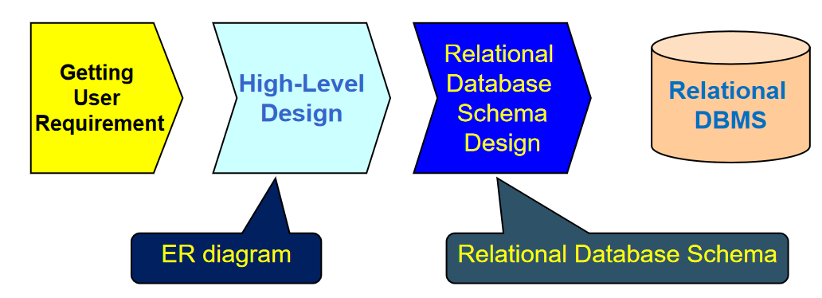
REVIEW
Studied:
ER diagram
Relational model
Convert ERD 🡪 Relational model
Now: we learn how to set up a relational database on DBMS

Slide 5
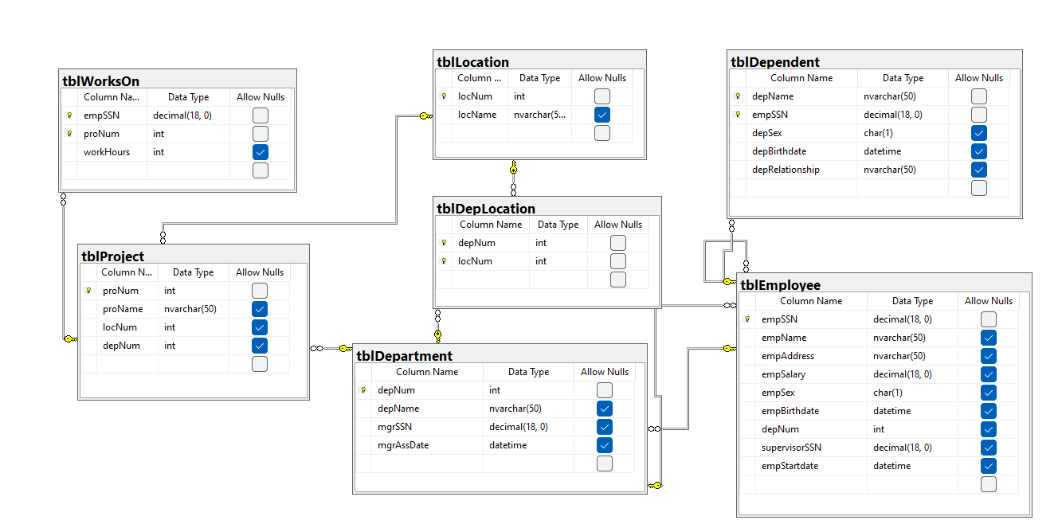
the company relational database schema

Slide 6
1. Integrity constraints
A "constraint" in a database refers to a rule or condition that limits the type of data that can be inserted into a table, ensuring data integrity and consistency
Purpose: prevent semantic inconsistencies in data
Kinds of integrity constraints:
1. Key Constraints (1 table): Primary key, Candidate key (Unique)
2. Attribute Constraints (1 table): NULL/NOT NULL; CHECK
3. Referential Integrity Constraints (2 tables): FOREIGN KEY
4. Global Constraints (n tables): CHECK or CREATE ASSERTION (self studying)
We will implement these constraints by SQL

Slide 7

Type | Definition | Purpose | Enforcement
Domain integrity | Ensures that all values in a column fall within a defined set of permissible values. | To ensure that the data in each column is accurate and consistent. | Enforced through data types, constraints (CHECK), and rules (NOT NULL).
Entity integrity | Ensures that each table has a primary key and that the primary key values are unique and not null. | To ensure that each row in in a table can be uniquely identified. | Enforced through PRIMARY KEY constraints, ensuring that no duplicate or null values exist in primary key columns.
Referential integrity | Ensures that a foreign key value always points to an existing, valid row in another table. | To maintain logical relationships between tables, preventing orphaned records. | Enforced through FOREIGN KEY constraints, ensuring that foreign key values match primary key values in related tables.

Slide 8
Data TYPE | USE CASE
INT | Used for integer values without decimals, suitable for counting, identifiers, and whole numbers.
DECIMAL | Used for exact numerical values with fixed precision and scale, suitable for financial calculations and quantities where exact precision is needed.
VARCHAR(n) | Used for variable-length character strings, suitable for text fields where the length can vary like names, emails, or descriptions.
TEXT | Used for large variable-length character strings, suitable for long text fields lik comments, articles, or product descriptions.
DATE | Used for date values, suitable for storing dates without time components like birthdays, anniversaries, or deadlines.
TIME | Used for time values, suitable for storing times without date components like office hours or appointment times.
DATETIME | Used for date and time values, suitable for storing precise moments in time like timestamps for events or logs.
BOOLEAN | Used for true/false values, suitable for binary conditions like status flags or feature toggles.

Slide 9
2. Structure Query Language
2.1. DDL - Data Definition Language
2.2. DML - Data Manipulation Language
2.3. DCL (self studying)- Data Control Language
2.4. Sub query

Slide 10
SQL Overview
SQL (sequel) is a database language designed for managing data in relational database management systems, and originally based upon relational algebra.
There are many different dialects of SQL
Ansi SQL (or SQL-86), SQL-92, SQL-99
SQL:2003, SQL:2006, SQL:2008, SQL:2009
Transact-SQL (T-SQL) is Microsoft's and Sybase's proprietary extension to SQL.
PL/SQL (Procedural Language/Structured Query Language) is Oracle Corporation's procedural extension for SQL and the Oracle relational database. Today, SQL is accepted as the standard RDBMS language

Slide 11
SQL Overview
SQL (sequel) is a database language designed for managing data in relational database management systems, and originally based upon relational algebra.
There are many different dialects of SQL
Ansi SQL (or SQL-86), SQL-92, SQL-99
SQL:2003, SQL:2006, SQL:2008, SQL:2009
Transact-SQL (T-SQL) is Microsoft's and Sybase's proprietary extension to SQL.
PL/SQL (Procedural Language/Structured Query Language) is Oracle Corporation's procedural extension for SQL and the Oracle relational database. Today, SQL is accepted as the standard RDBMS language

Slide 12
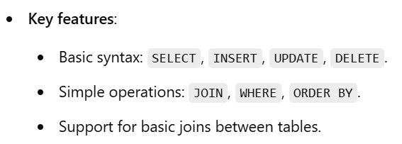
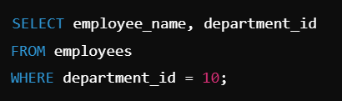
Ansi SQL (or SQL-86)
SQL-86 (also known as SQL-1 or ANSI SQL) is the first version of SQL, standardized in 1986 by ANSI (American National Standards Institute).

Slide 13
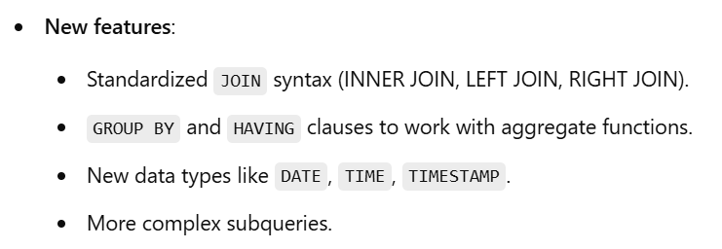
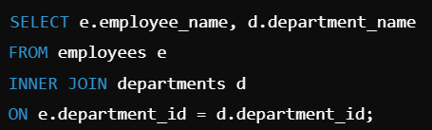
SQL-92

Slide 14
Data Definition Language - CREATE
Database schema
Simple syntax: CREATE DATABASE dbname
Full syntax: https://docs.microsoft.com/en-us/sql/database
Relation schema ~ table
Full syntax: https://docs.microsoft.com/en-us/sql/table
CREATE TABLE tableName
(
fieldname1 datatype [integrity_constraints],
fieldname2 datatype [integrity_constraints],
….
)

Slide 15
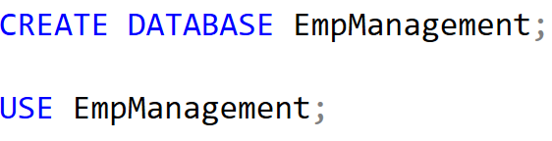
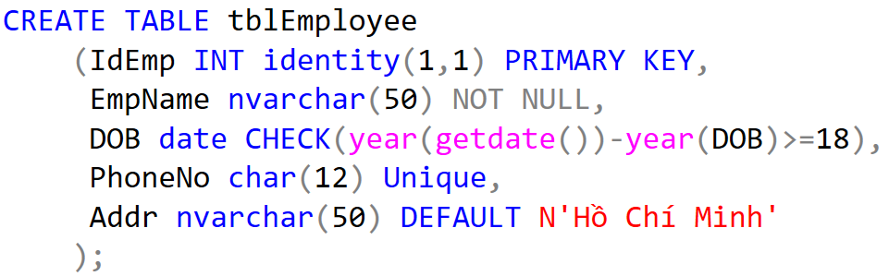
Data Definition Language - Demo

Slide 16
Data Definition Language – ALTER, DROP
Used to modify the structure of table, database
Add more columns
ALTER TABLE tableName
ADD columnName datatype [constraint]
Remove columns
ALTER TABLE tableName
DROP column columnName
Modify data type
ALTER TABLE tableName
ALTER column columnName datatype [constraint]

Slide 17
Data Definition Language– ALTER, DROP
Add/remove constraints
ALTER TABLE tablename
ADD CONSTRAINT constraintName PRIMARY KEY
(<attribute list>);
ALTER TABLE tablename
ADD CONSTRAINT constraintName FOREIGN KEY (<attribute list>)
REFERENCES parentTableName (<attribute list>);

Slide 18
Data Definition Language– ALTER, DROP
Add/remove constraints
ALTER TABLE tablename
ADD CONSTRAINT constraintName CHECK (expressionChecking)
(self studying)
ALTER TABLE tablename
DROP CONSTRAINT constraintName

Slide 19
Data Definition Language– ALTER, DROP
Remove Table/ Database
DROP TABLE TableName
DROP DATABASE dbName

Slide 20
Physical Diagram - FUHCompany
2.2. DML - Data Manipulation Language
01
INSERT
02
UPDATE
Click here to add text
Click here to add text
03
DELETE
04
SELECT
Click here to add text
Click here to add text

Slide 21
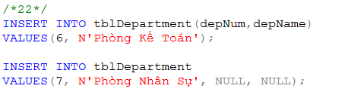
Data Manipulation Language (DML)
1. INSERT
INSERT INTO tableName
VALUES (<value 1>, ... <value n>)
INSERT INTO tableName(<listOfFields>)
VALUES (<value 1>, ... <value m>)
INSERT INTO tableName
SELECT listOfFields FROM another_tableName

Slide 22

Data Manipulation Language (DML)
2. UPDATE
UPDATE tableName
SET columnName = newValue
[WHERE condition]
Note: newValue could be a value/ an expression/ a SQL statement
Example: Update new salary and depNum for the employee named ‘Mai Duy An’

Slide 23
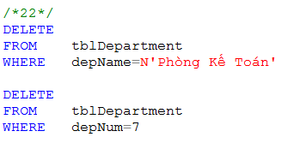
Data Manipulation Language (DML)
3. DELETE
DELETE FROM tableName
[WHERE condition]
TRUNCATE TABLE tableName
What is difference between DELETE and TRUNCATE?
What should we do before implement DELETE or TRUNCATE? (referential integrity constraint)
Example:
remove a department named ‘Phòng Kế Toán’
remove a department which depNum is 7

Slide 24
Data Manipulation Language (DML)
4. SELECT
SQL Queries and Relational Algebra
SELECT L
FROM R
WHERE C
π_{L}(σ_{C}(R))

Slide 25
T-SQL : Basic Syntax for a simple SELECT queries
4. SELECT
SELECT [ ALL | DISTINCT ] [ TOP n [ PERCENT ] ]
* | {column_name | expression [alias],…}
[FROM table]
[WHERE conditions]
SELECT identifies what columns
ALL: Specifies that duplicate rows can appear in the result set. ALL is the default
DISTINCT: Specifies that only unique rows can appear in the result set. Null values are considered equal for the purposes of the DISTINCT keyword
TOP n [ PERCENT ]:Specifies that only the first n rows are to be output from the query result set. n is an integer between 0 and 4294967295. If PERCENT is also specified, only the first n percent of the rows are output from the result set. When specified with PERCENT, n must be an integer between 0 and 100
FROM identifies which table
The WHERE clause follows the FROM clause. Condition: is composed of column names, expressions, constants, and a comparison operator

Slide 26
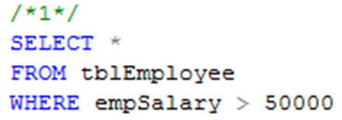
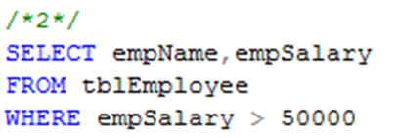
Common Query in SQL
4. SELECT
Ex1: Listing all employees whose salary exceed at 50000
Ex2: Listing name and salary of all employees whose income exceed 50000

Slide 27
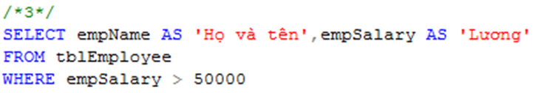
Projection in SQL
4. SELECT
Using alias name in select clause
Example 3:
Listing full name and salary of all employees whose income exceed 50000

Slide 28
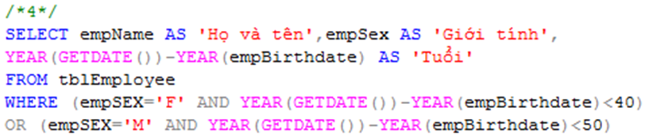
Selection in SQL
4. SELECT
Example 4
List all under 40 year-old female or under 50 year-old male employees

Slide 29
Ordering the Output
4. SELECT - ORDER BY
Presenting the tuples produced by a query in sorted order
The order may be based on the value of any attribute
Syntax
Order by clause follows Where and any other clauses. The ordering is performed on the result of the From, Where, and other clauses, just before Select clause
Using keyword ASC for ascending order and DESC for descending order
SELECT <list of attributes>
FROM <list of tables>
WHERE <conditions>
ORDER BY <list of attributes> [ASC/DESC]

Slide 30

Ordering the Output
4. SELECT - ORDER BY
Example 6:
Listing all employee by department number ascreasingly, then by salary descreasingly

Slide 31
Queries Involving More Than One Relation
4. SELECT - joins
SQL allows we combine two or more relations through joins, products, unions, intersections, and differences.
When data from more than one table in the database is required, a join condition is used.
Simple way to couple relations: list each relation in the From clause
Other clauses in query can refer to the attributes of any of the relations in the From clause.

Slide 32

Products and Joins in SQL
4. SELECT - joins
Example 7: List all employees who work on ‘Phòng Phần mềm trong nước’ department

Slide 33
What we do if …
4. SELECT - joins
Questions:
...a query involves several relations, and there are two or more attributes with the same name?
May we list a relation R as many times as we need?
May we use tuple variables to refer to each occurrence of R?

Slide 34

Disambiguating Attributes
4. SELECT - joins
Example 8:
Find all cities in which our company is

Slide 35

What we do if …
4. SELECT - joins
… a query involves two or more tuples from the same relation?
Example 9:
Find all those project numbers which have more than two members

Slide 36
Union, Intersection, Difference of Queries
4. SELECT - UNION, INTERSECT, and EXCEPT
We combine relations using the set operations of relational algebra: union, intersection, and difference
SQL provides corresponding operators with UNION, INTERSECT, and EXCEPT for ∪, ∩, and -, respectively

Slide 37


Union, Intersection, Difference of Queries
4. SELECT - UNION, INTERSECT, and EXCEPT
Example 10.1 Find all those employees whose name is begun by ‘H’ or salary exceed 80000
Example 10.2 Find all those normal employees, that is who do not supervise any other employees

Slide 38
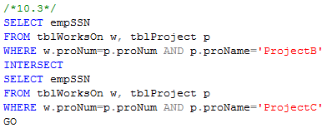
Example 10.3
Find all employees who work on projectB and project C

Slide 39
Sub-queries
4. SELECT - sub-query
- A query can be used to help in the evaluation of another
- A query that is part of another is called a sub-query
Sub-queries return a single constant, this constant can be compared with another value in a WHERE clause
Sub-queries return relations, that can be used in WHERE clause
Sub-queries can appear in FROM clauses, followed by a tuple variable

Slide 40
Sub-queries that Produce Scalar Values
4. SELECT - sub-query
An atomic value that can appear as one component of a tuple is referred to as a scalar.
Let’s compare two queries for the same request

Slide 41
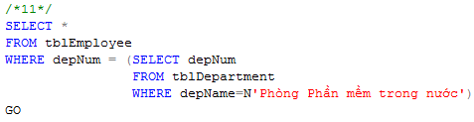
Example 7&11: Find the employees of Phòng Phần mềm trong nước department

Slide 42
Conditions Involving Relations
4. SELECT - EXIST-IN-ALL-ANY
Some SQL operators can be applied to a relation R and produce a bool result
(EXISTS R = True) ⇔ R is not empty
(s IN R = True) ⇔ S is equal to one of the values of R
(s > ALL R = True) ⇔ s is greater than every values in unary R
(s > ANY R = True) ⇔ s is greater than at least one value in unary R

Slide 43
Conditions Involving Tuples
4. SELECT - between...and
A tuple in SQL is represented by a list of scalar values between ()
If a tuple t has the same number of components as a relation R, then we may compare t and R with IN, ANY, ALL

Slide 44
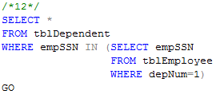
Example 12:
Find the dependents of all employees of department number 1

Slide 45
Correlated Sub-queries
4. SELECT (cont.)
To now, sub-queries can be evaluated once and for all, the result used in a higher-level query.
But, some sub-queries are required to be evaluated many times
That kind of sub-queries is called correlated sub-query
Note: Scoping rules for names

Slide 46
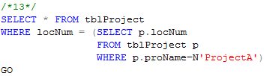
Example 13:
Find all those projects have the same location with projectA

Slide 47
Another example:
Find the titles that have been used for two or movies
SELECT title
FROM Movies Old
WHERE year < ANY
(SELECT year
FROM Movies
WHERE title = Old.title)

Slide 48
Sub-queries in FROM Clauses
sub query
In a FROM list we can use a parenthesized sub-query
We must give it a tuple-variable alias
Example: Find the employees of Phòng Phần mềm trong nước
SELECT *
FROM tblEmployee e, (SELECT depNum
FROM tblDepartment
WHERE depName=N'Phòng phần mềm trong nước') d
WHERE e.depNum = d.depNum

Slide 49
Correlated Sub-queries
sub query
To now, sub-queries can be evaluated once and for all, the result used in a higher-level query.
But, some sub-queries are required to be evaluated many times
That kind of sub-queries is called correlated sub-query
Note: Scoping rules for names

Slide 50
SQL Join Expressions
sub query
SQL Join Expressions can be stand as a query itself or can be used as sub-queries in FROM clauses
Cross Join in SQL= Cartesian Product
Syntax: R CROSS JOIN S;
Meaning: Each tuple of R connects to each tuple of S
Theta Join with ON keyword
Systax: R JOIN S ON R.A=S.A;
Meaning: Each tuple of R connects to those tuples of S, which satisfy the condition after ON keyword

Slide 51

Example 15.1
Product two relations Department and Employee
Example 15.2
Find departments and employees who work in those departments, respectively

Slide 52
Natural Joins
natural join
A natural join differs from a theta-join in that:
The join condition: all pairs of attributes from the two relations having a common name are equated, and there are no other condition
One of each pair of equated attributes is projected out
Syntax : Table1 NATURAL JOIN Table2
Microsoft SQL SERVER DONOT SUPPORT NATURAL JOINS AT ALL

Slide 53
Outer Joins
natural join
The outer join is a way to augment the result of join by the dangling tuples, padded with null values
When padding dangling tuples from both of its arguments, we use full outer join
When padding from left/right side, we use left outer join/right outer join

Slide 54


Example 17.1:
For each location, listing the projects that are processed in it
Example 17.2:
For each department, listing the projects that it controls

Slide 55
Eliminating Duplicates
SELECT DISTINCT
Study some operations that acts on relations as whole, rather than on tuples individually
A relation, being a set, cannot have more than one copy of any given tuple
But, the SQL response to a query may list the same tuple several times, that is, SELECT preserves duplicates as a default
So, by DISTINCT we can eliminate a duplicates from SQL relations

Slide 56
Eliminating Duplicates
SELECT DISTINCT
Example 17.3: List all location in which the projects are processed.
Location name is repeated many times
SELECT DISTINCT l.locNum, l.locName
FROM tblLocation l JOIN tblProject p ON l.locNum=p.locNum
SELECT DISTINCT l.locNum, l.locName
FROM tblLocation l JOIN tblProject p ON l.locNum=p.locNum

Slide 57
Duplicates in Unions, Intersections, and Differences
all
Set operations on relations will eliminate duplicates automatically
Use ALL keyword after Union, Intersect, and Except to prevent elimination of duplicates
Syntax:
R UNION ALL S;
R INTERSECT ALL S;
R EXCEPT ALL S;

Slide 58
Grouping and Aggregation in SQL
GROUP BY
Grouping operator partitions the tuples of relation into groups, based on the values of tuples in one or more attributes
After grouping the tuples of relation, we are able to aggregate certain other columns of relation
We use GROUP BY clause in SELECT statement

Slide 59
Aggregation Operators
sum - avg - min - max - count
Five aggregation operators
SUM acts on single numeric column
AVG acts on single numeric column
MIN acts on single numeric column
MAX acts on single numeric column
COUNT act on one or more columns or all of columns
Eliminating duplicates from the column before applying the aggregation by DISTINCT keyword

Slide 60


Aggregation Operators
sum - avg - min - max - count
Example 18.1
Find average salary of all employees
Example 18.2
Find number of employees

Slide 61
Grouping
sum - avg - min - max - count
To partition the tuples of relation into groups
Syntax
SELECT <list of attributes>
FROM <list of tables>
WHERE <condition>
GROUP BY <list of attributes>

Slide 62

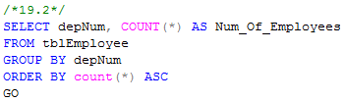
Grouping
sum - avg - min - max - count
Example 19.1:
Group employees by department number
Example 19.2
List number of employees for each department number

Slide 63
Grouping
select
There are two kinds of terms in SELECT clause
Aggregations, that applied to an attribute or expression involving attributes
Grouping Attributes, that appear in GROUP BY clause
A query with GROUP BY is interpreted as follow:
Evaluate the relation R expressed by the FROM and WHERE clauses
Group the tuples of R according to the attributes in GROUP BY clause
Produce as a result the attributes and aggregation of the SELECT clause

Slide 64

Grouping
select
Example 20
Compute the number of employees for each project

Slide 65
Grouping, Aggregation, and Nulls
select - NULLs
When tuples have nulls, there are some rules:
The value NULL is ignored in any aggregation
Count(*): a number of tuples in a relation
Count(A): a number of tuples with non-NULL values for A attribute
NULL is treated as an ordinary value when forming groups
The count of empty bag is 0, other aggregation of empty bag is NULL

Slide 66
Example: Suppose R(A,B) as followed
The result of query
SELECT A, count(B)
FROM R
GROUP BY A;
is one tuple (NULL,0)
The result of query
SELECT A, sum(B)
FROM R
GROUP BY A;
is one tuple (NULL,NULL)
A | B
NULL | NULL

Slide 67
Considerations …
select - having
If we want to apply conditions to tuples of relations, we put those conditions in WHERE clause.
If we want to apply conditions to groups of tuples after grouping, those conditions are based on some aggregations, how can we do?
In that case, we follow the GROUP BY clause with a HAVING clause

Slide 68
HAVING clause
select - having
Syntax:
SELECT <list of attributes>
FROM <list of tables>
WHERE <conditions on tuples>
GROUP BY <list of attributes>
HAVING <conditions on groups>

Slide 69
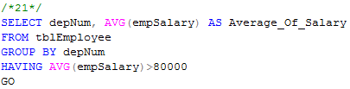
HAVING clause
select - having
Example 21:
Print the number of employees for each those department, whose average salary exceeds 80000

Slide 70
HAVING clause
select - having
Some rules about HAVING clause
An aggregation in a HAVING clause applies only to the tuples of the group being tested
Any attribute of relations in the FROM clause may be aggregated in the HAVING clause, but only those attributes that are in the GROUP BY list may appear un-aggregated in the HAVING clause (the same rule as for the SELECT clause)

Slide 71
Example:
SELECT proNum, COUNT(empSSN) AS Number_Of_Employees,
FROM tblWorksOn
GROUP BY proNum
HAVING AVG(workHours)>20
SELECT proNum, COUNT(empSSN) AS Number_Of_Employees,
FROM tblWorksOn
GROUP BY proNum
HAVING proNum=4

Slide 72
COMPARITION

Slide 73
Comparison of Strings
Two strings are equal (=) if they are the same sequence of characters.
Other comparisons: <, >, ≤, ≤, <>
Suppose a=a₁a₂…a_{n} and b=b₁b₂…b_{m} are two strings, the first is less than the second if
∃k≤min(n,m):
∀i, 1≤i≤k: a_{i} = b_{i}, and
a_{k+1}<b_{k+1}
Example
fodder < foo
bar < bargain

Slide 74
Pattern Matching in SQL
Like or Not Like
Two special characters
% means any sequence of 0 or more characters
_ means any one character
SELECT
FROM
WHERE s LIKE p;
SELECT
FROM
WHERE s NOT LIKE p;

Slide 75


Pattern Matching in SQL
Example 5.1: Find all employees named as ‘Võ Việt Anh’
Example 5.2: Find all employees whose name is ended at ‘Anh’

Slide 76
Pattern Matching in SQL
USING ESCAPE keyword
SQL allows us to specify any one character we like as the escape character for a single pattern
Example:
WHERE s LIKE ‘%20!%%’ ESCAPE !
Or WHERE s LIKE ‘%20@%%’ ESCAPE @
🡺 Matching any s string contains the 20% string
WHERE s LIKE ‘x%%x%’ ESCAPE x
🡺 Matching any s string that begins and ends with the character %

Slide 77
Dates and Times
Dates and times are special data types in SQL
A date constant’s presentation
DATE ‘1948-05-14’
A time constant’s presentation
TIME ‘15:00:02.5’
A combination of dates and times
TIMESTAMP ‘1948-05-14 12:00:00’
Operations on date and time
Arithmetic operations
Comparison operations

Slide 78
Null Values
Null value: special value in SQL
Some interpretations
Value unknown: there is, but I don’t know what it is
Value inapplicable: there is no value that makes sense here
Value withheld: we are not entitled to know the value that belongs here
Null is not a constant
Two rules for operating upon a NULL value in WHERE clause
Arithmetic operators on NULL values will return a NULL value
Comparisons with NULL values will return UNKNOWN

Slide 79
The Truth-Value UNKNOWN
Truth table for True, False, and Unknown
We can think of TRUE=1; FALSE=0; UNKNOWN=1/2, so
x AND y = MIN(x,y); x OR y = MAX(x, y); NOT x = 1-x
x | y | x AND y | x OR y | NOT x
TRUE | TRUE | TRUE | TRUE | FALSE
TRUE | UNKNOWN | UNKNOWN | TRUE | FALSE
TRUE | FALSE | FALSE | TRUE | FALSE
UNKNOWN | TRUE | UNKNOWN | TRUE | UNKNOWN
UNKNOWN | UNKNOWN | UNKNOWN | UNKNOWN | UNKNOWN
UNKNOWN | FALSE | FALSE | UNKNOWN | UNKNOWN
FALSE | TRUE | FALSE | TRUE | TRUE
FALSE | UNKNOWN | FALSE | UNKNOWN | TRUE
FALSE | FALSE | FALSE | FALSE | TRUE

Slide 80
The Truth-Value Unknown
SQL conditions in Where clause produce three truth values: True, False, and Unknown
Those tuples which condition has the value True become part of the answer
Those tuples which condition has the value False or Unknown are excluded from the answer

